Slide 1
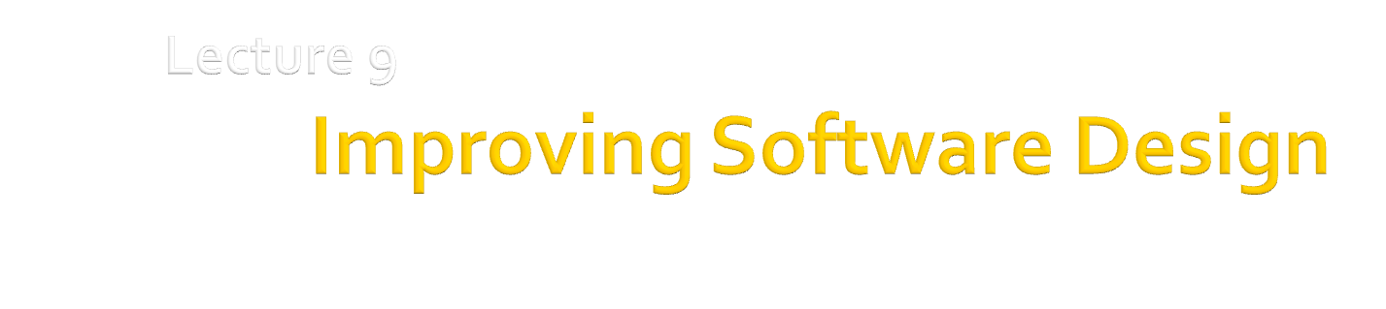
Dr. Hesam Chiniforoshan
se.usc.ac.ir@gmail.com

Slide 2
Outline
2
Cohesion & Coupling
SOLID Design Principles

Slide 3
Cohesion & Coupling
3

Slide 4
Coupling: Degree of dependence among components
No dependencies
Loosely coupled-some dependencies
High coupling makes modifying parts of the system difficult, e.g., modifying a component affects all the components to which the component is connected.
Highly coupled-many dependencies
Why high coupling is problematic?

Slide 5
Coupling
Content Coupling
One component references contents of another
One component modifies or relies on the internal workings of another module
Common Coupling
Two components share the same global data
Control Coupling
One Component controls the flow of another, by passing it information on what to do
Component passes control parameters to coupled components
5
Notes:
Content Coupling Example
Part of program handles lookup for customer. When customer not found, component adds customer by directly modifying the contents of the data structure containing customer data.
Improvement:
When customer not found, component calls the AddCustomer() method that is responsible for maintaining customer data.
/////////////////////////////
Common Coupling Example
Process control component maintains current data about state of operation. Gets data from multiple sources. Supplies data to multiple sinks.
Each source process writes directly to global data store. Each sink process reads directly from global data store.
Improvement
Data manager component is responsible for data in data store. Processes send data to and request data from data manager
////////////////////////////////

Slide 6
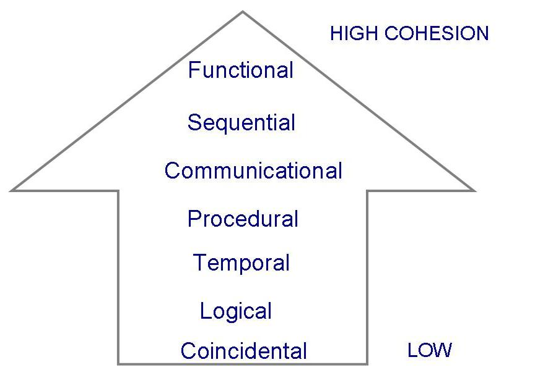
Cohesion
A component is cohesive if all elements of the component are directed toward and essential for performing the same task
Several forms of cohesion:

Slide 7
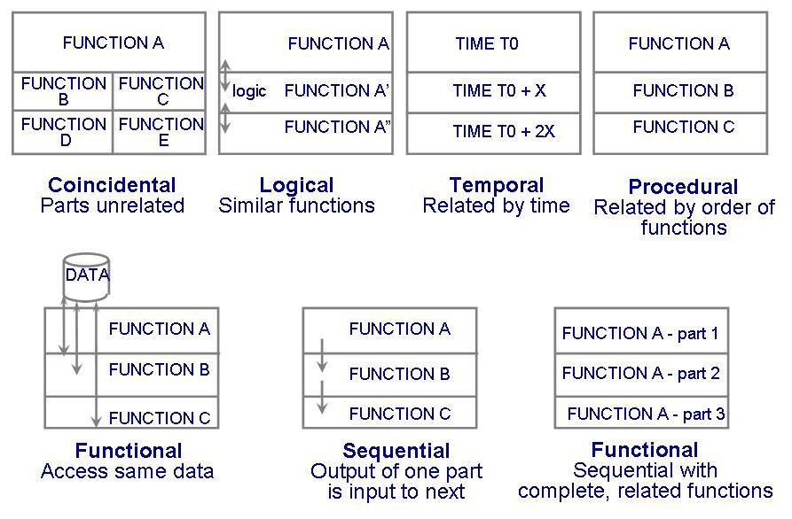
Cohesion
Communicational
7

Slide 8
Cohesion
Coincidental Cohesion
Parts of the component are only related by their location in source code
Logical Cohesion
Elements of component are related logically and not functionally
Temporal Cohesion
Elements of a component are related by timing
Procedural
Elements of a component are related only to ensure a particular order of execution.
8
Notes:
Logical Cohesion Example
A component reads inputs from tape, disk, and network. All the code for these functions are in the same component. Operations are related, but the functions are significantly different.
Improvement
A device component has a read operation that is overridden by sub-class components. The tape sub-class reads from tape. The disk sub-class reads from disk. The network sub-class reads from the network.
-------------------------------
Temporal Cohesion Example
A system initialization routine: this routine contains all of the code for initializing all of the parts of the system. Lots of different activities occur, all at init time.
Improvement
A system initialization routine sends an initialization message to each component.
Each component initializes itself at component instantiation time.
----------------------------------

Slide 9
Cohesion
Communicational Cohesion
Module performs a series of actions related by a sequence of steps to be followed by the product and all actions are performed on the same data
Sequential Cohesion
The output of one component is the input to another. Occurs naturally in functional programming languages
Functional Cohesion
Every essential element to a single computation is contained in the component
9

Slide 10
S.O.L.I.D. Design Principles
10

Slide 11
Software “Smell” Another perspective
The system is rigid
Hard to change because everything has to change at once
Code Smell . . .
Shotgun Surgery
The system is fragile
Changes cause the system to break in the strangest of places.
The system is immobile
That is, not reusable.
The system is opaque
Hard to understand.
The system is needlessly complex
The system contains needless repetition.
Have you ever seen software with these problems?

Slide 12
SOLID Design Principles
Single Responsibility Principle
Open/Closed Principle
Liskov Substitution Principle
Interface Segregation Principle
Dependency Inversion Principle
Introduced by Robert C. Martin
Agile Principles, Patterns, and Practices in C#
S
O
L
I
D
Notes:
SOLID is an acronym of 5 acronyms

Slide 13
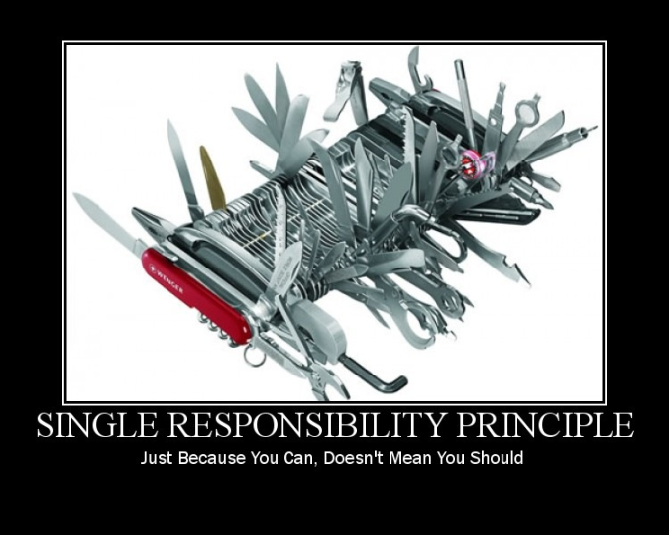
Single Responsibility Principle (SRP)
Just because you can, doesn’t mean you should.
A class should have only one reason to change

Slide 14
Single Responsibility Principle (SRP)
A class should have only one reason to change
A responsibility is “a reason for change.”
The responsibilities of a class are axes of change.
If it has two responsibilities, they are coupled in the design, and so have to change together.
If a class has more that one responsibility, it may become fragile when any of the requirements change

Slide 15
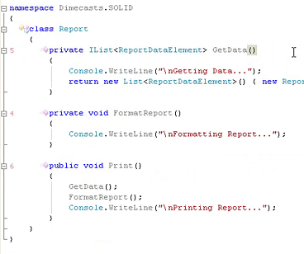
SRP – Example
Report
GetData()
FormatReport()
Print()

Slide 16
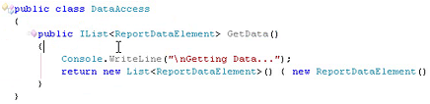
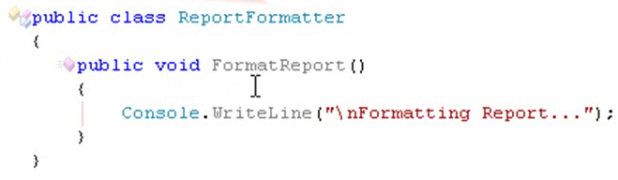
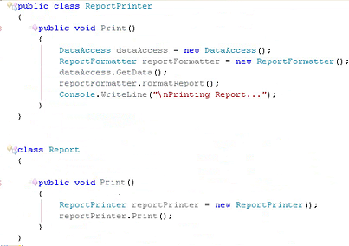
SRP – Example cnt.

Slide 17
SRP – Example cnt.
Report
ReportPrinter
Print()
Print()
Report
GetData()
FormatReport()
Print()
ReportFormater
DataAccess
FormatReport()
GetData()
Notes:
Refactor individual responsibilities to individual classes

Slide 18
Benefits of SRP
code is smaller
easier to read
easier to understand
easier to maintain
Code is potentially easier to test
Change is easier to manage
code is easier to replace

Slide 19
Open/Closed Principle (OCP)
Software entities (module, classes, functions, etc.) should be
open for extension but closed for modification
Classes should be written so that they can be extended without requiring modification.
extend the behaviour of a system (in response to a requested change)
add new code
But not modifying the existing code
Once completed, the implementation of a class should only be modified to correct errors; new or changed features would require that a different class be created
Mechanism?
Abstraction and subtype polymorphism are the keys to the OCP
Introducing Abstract Base Classes
Implementing common Interfaces
Deriving from common interfaces or classes

Slide 20
OCP – Example
Changing the print code
Format the report into tabloid (instead of 8-1/2 X 11)
Print the report to a dot-matrix (instead of laser) printer
Report
ReportPrinter
Print()
Print()
ReportFormater
DataAccess
FormatReport()
GetData()

Slide 21
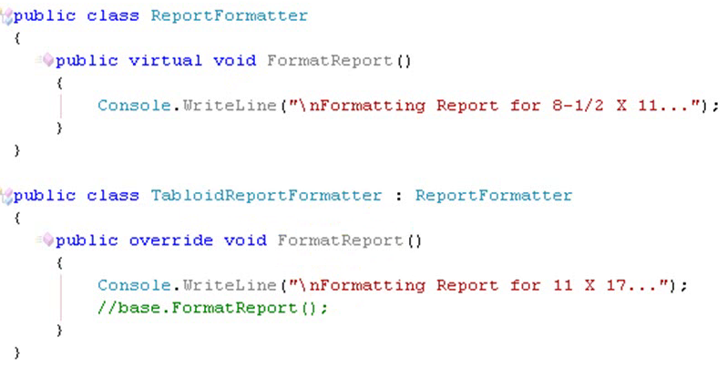
OCP – Example ct.
Report
ReportPrinter
Print()
Print()
ReportFormater
DataAccess
FormatReport()
GetData()

Slide 22
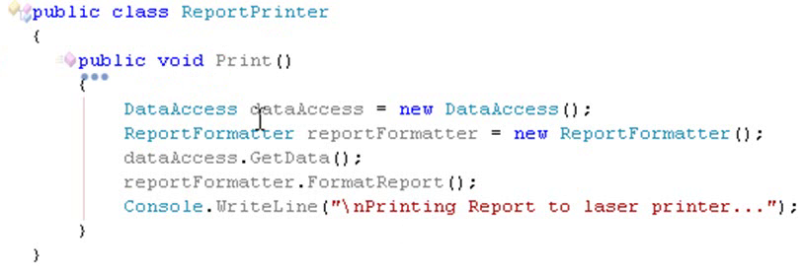
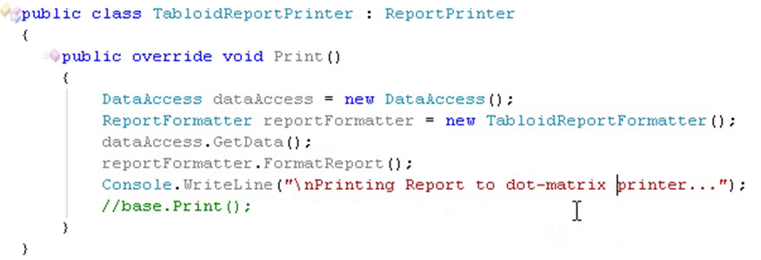
OCP – Example cnt.

Slide 23
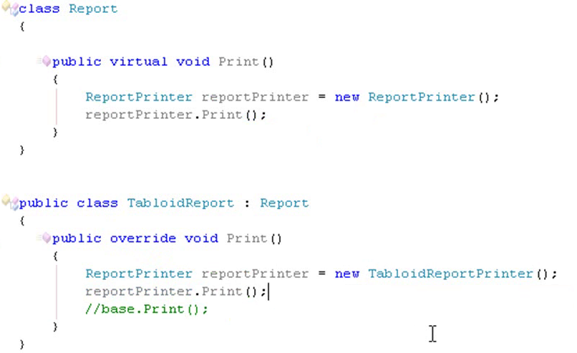
OCP – Example cnt.
Note the extension of the system behaviour without making modification to existing code

Slide 24
OCP – Example cnt.
UML Class Diagram
DataAccess
Report
ReportPrinter
GetData()
Print()
ReportFormater
Print()
Format()
TabloidReport
TabloidReportPrinter
TabloidReportFormater
Print()
Print()
Format()
Notes:
We made some minor classes. For instance in the base classes we declared the methods as “Virtual” then to allow derived classes override them

Slide 25
Benefits of OCP
design is more stable
existing (working) code does not change
changes are made by adding, not modifying, code
changes are isolated and do not cascade throughout the code
code is potentially easier to test
change is easier to manage
code is easier to replace
design is extensible
code is potentially reusable
Higher abstraction

Slide 26
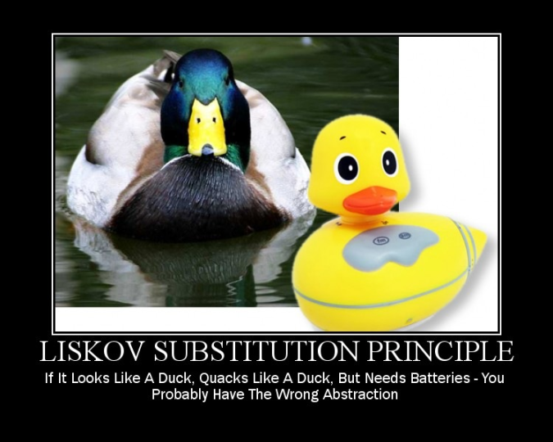
Liskov Substitution Principle (LSP)
Subclasses should be substitutable for their base classes

Slide 27
Liskov Substitution Principle (LSP)
Subclasses should be substitutable for their base classes
LSP states that if a program module is using a Base class, then the reference to the Base class can be replaced with a Derived class without affecting the functionality of the program module.
“A derived class should have some kind of specialized behaviour (it should provide the same services as the superclass, only some, at least, are provided differently.)”
The contract of the base class must be honoured by the derived class.
If this principle is violated, then it will cause the Open-Closed Principle to be violated also. Why?
Notes:
n programming, the Liskov substitution principle states that if S is a subtype of T, then objects of type T may be replaced (or substituted) with objects of type S. This can be formulated mathematically as
Let ϕ(x) be a property provable about objects x of type T. Then ϕ(y) should be true for objects y of type S, where S is a subtype of T.

Slide 28
LSP – Benefits
design is more flexible
a base type can be confidently substituted for a derived type
code is potentially easier to test
required to support the Open/Closed Principle

Slide 29
Interface Segregation Principle (ISP)
Many client-specific interfaces are better than one general purpose interface
Clients should not depend on interfaces that they do not use
Interfaces should be thin and not fat
E.g. if you have an interface with 20 methods, then not all implementers of that interface might implement all of those methods
Bring large and fat interfaces into smaller ones which classify the related methods
If you have a class with several different uses, create separate (narrow) interfaces for each use.
Why ISP?
The purpose is to make clients use as small and as coherent an interface as possible.
Fat interfaces lead to inadvertent couplings and accidental dependencies between classes.

Slide 30
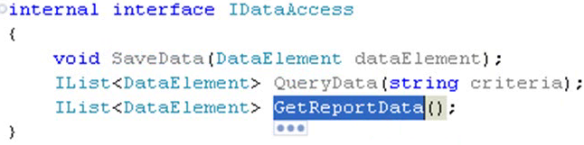
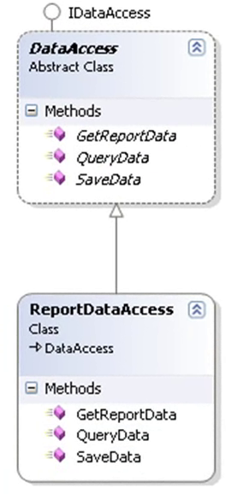
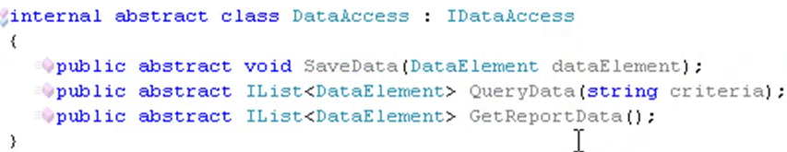
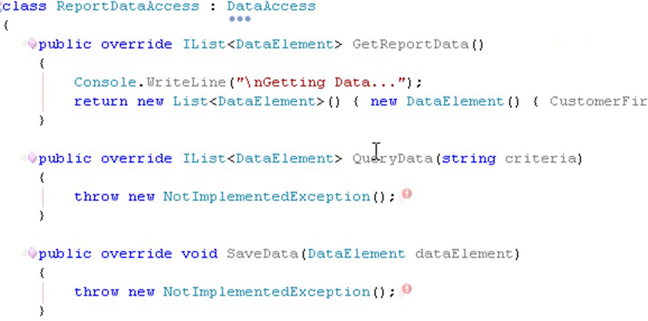
ISP – Example

Slide 31
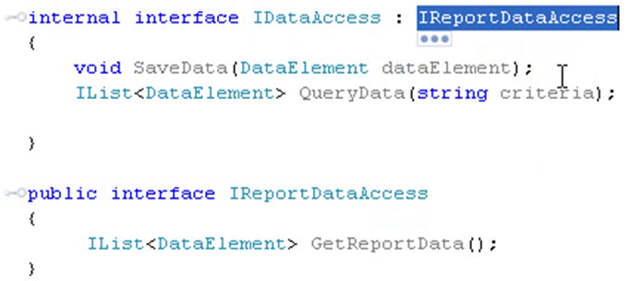
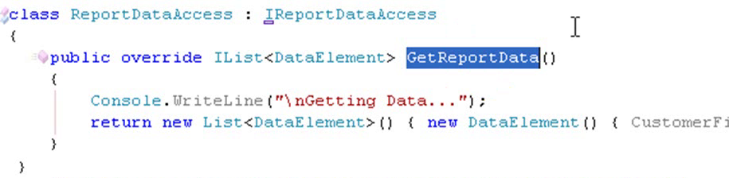
ISP – Example cnt.
Breaking the fat interface of IDataAccess into two smaller ones:
Class that implements the interface does no longer need to implement all methods of the class which it does not need

Slide 32
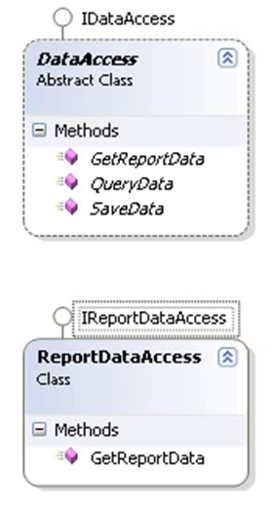
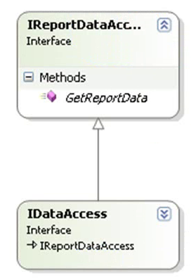
ISP – Example cnt.

Slide 33
ISP – Benefits
Cohesion is increased
clients can demand cohesive interfaces
Design is more stable
changes are isolated and do not cascade throughout the code
Supports the Liskov Substitution Principle (Why?)

Slide 34
Dependency Inversion Principle (DIP)
High level modules should not depend on low level modules
both should depend upon abstractions
Dependency upon lower-level components limits the reuse opportunities of the higher-level components
Abstractions should not depend on details
Change the relation between concrete classes to relationships among abstractions
Abstraction mechanism: Abstract base classes or Interfaces
The goal of the dependency inversion principle is to
decouple high-level components from low-level components
such that reuse with different low-level component implementations becomes possible
High level classes should contain the “business logic”, low level classes should contain the details of the (current) implementation.
Access instances using interfaces or abstract classes to avoid dependency inversion.

Slide 35
DIP – Example
DataAccess
Report
ReportPrinter
GetData()
Print()
ReportFormater
Print()
Format()
TabloidReport
TabloidReportPrinter
TabloidReportFormater
Print()
Print()
Format()
Notes:
There is a relationship between Program class and Report class, in terms of concrete classes, rather than abstractions

Slide 36
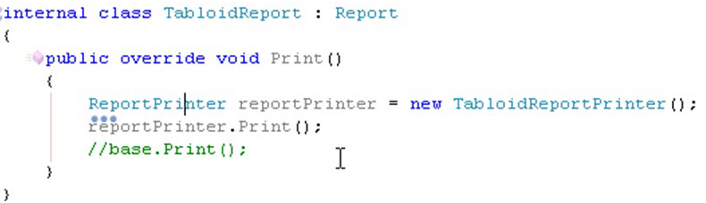
DIP
TabloidReport
ReportPrinter
Print()
Print()
IReportPrinter
<<Interface>>
TabloidReport
Print()
Print()
ReportPrinter
Print()
Notes:
Implementation level relations between TabloidPrint class and ReportPrinter (dependencies in terms of concrete types rather than interfaces)

Slide 37
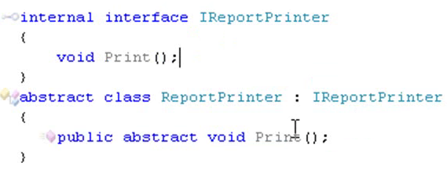
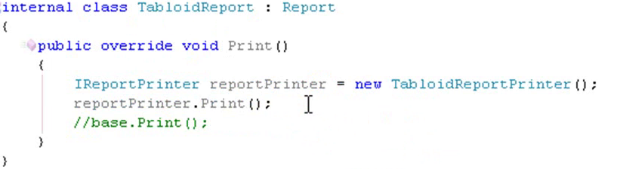
DIP
Notes:
Implementation level relations between TabloidPrint class and ReportPrinter (dependencies in terms of concrete types rather than interfaces)

Slide 38
DIP – Beefits
Enables design by contract
change is easier to manage
code is easier to replace
design is extensible
code is potentially easier to test
38

Slide 39
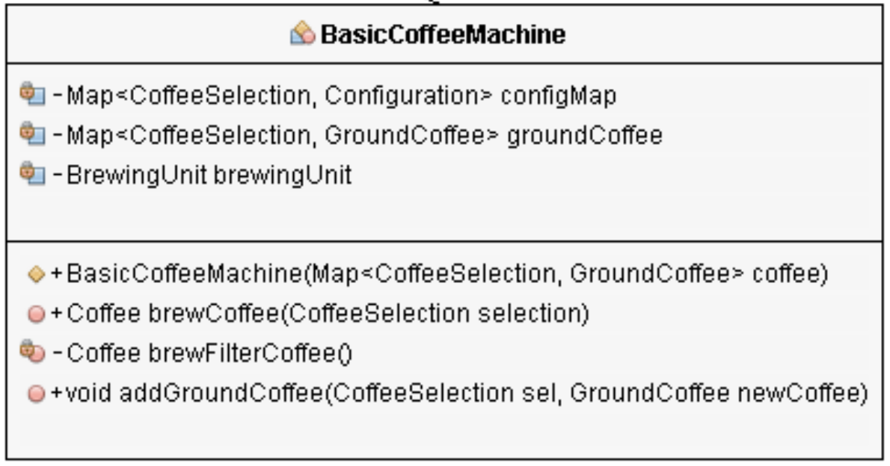

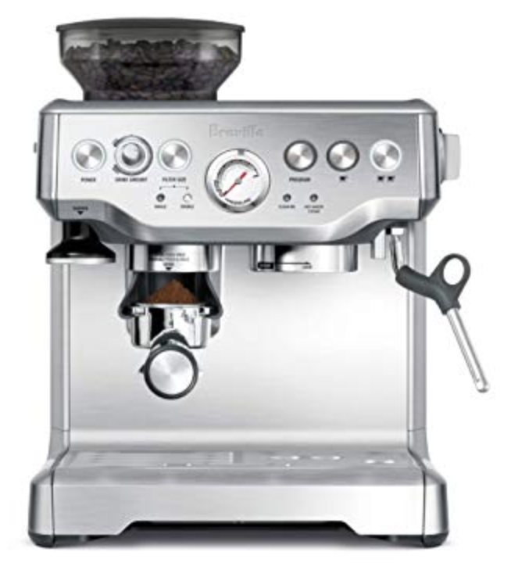
Design Practice 1
You have this class for controlling key functionalities of a basic coffee machine
Now your company has made an Advanced Coffee machine, which has a Grinder and Espresso maker as well. How would you change the code of BasicCoffeeMachine to make a controller for the advanced machine?

Slide 40
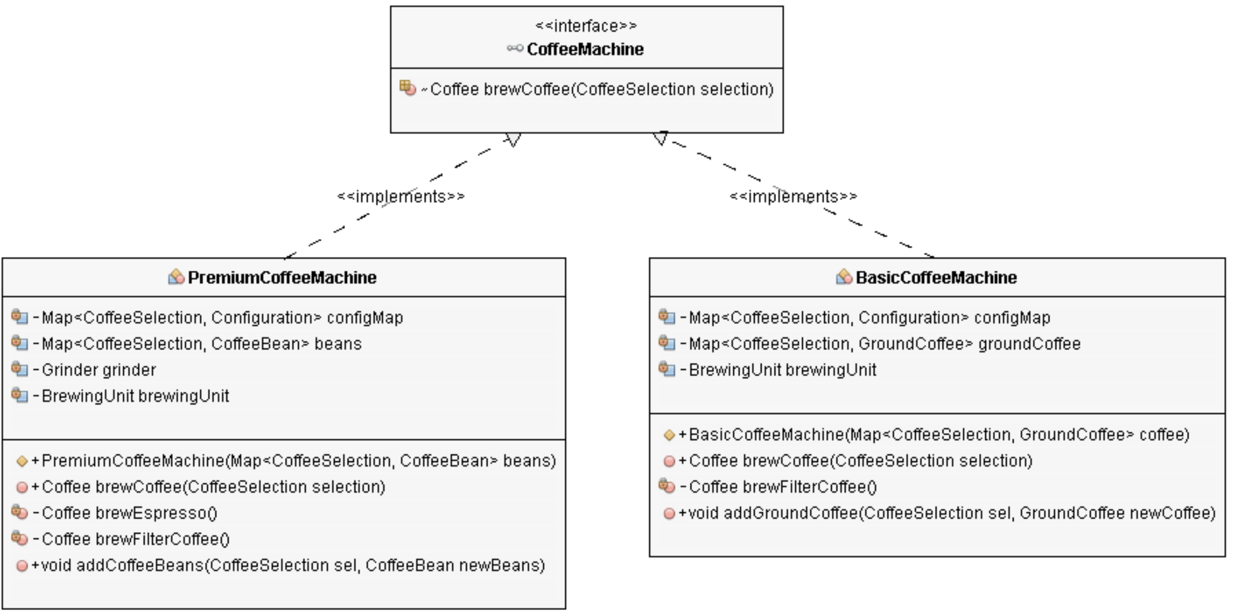
Design Practice 1
This design is based on Open/Close Principle

Slide 41
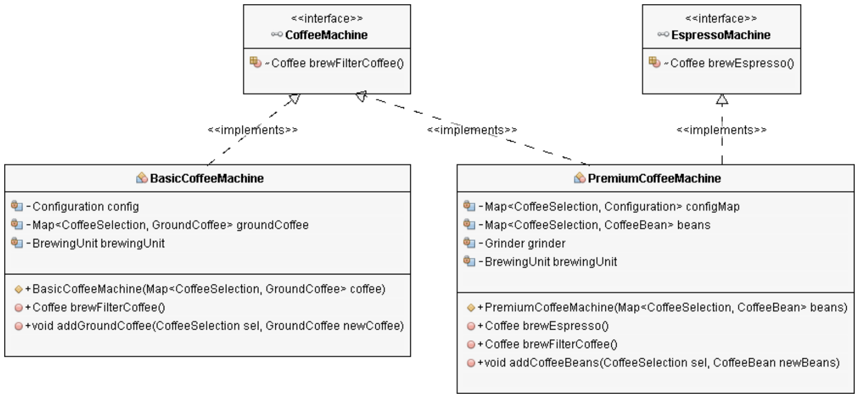
Design Practice 1
This design applies Dependency Inversion Principle

Slide 42
Which SOLID design principle is violated in this code?
public class Book {
private String name;
private String author;
private String text;
//constructor, getters and setters
// methods that directly relate to the book properties
public String replaceWordInText(String word){
return text.replaceAll(word, text);
}
public boolean isWordInText(String word){
return text.contains(word);
}
.
.
.
void printTextToConsole(){
// our code for formatting and printing the text
}
}

Slide 43
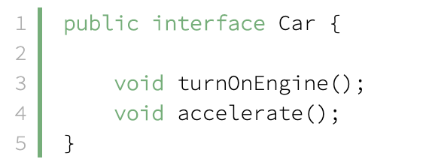
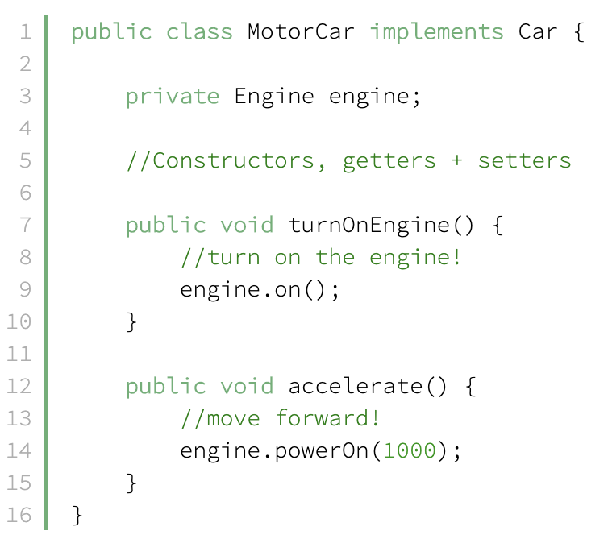
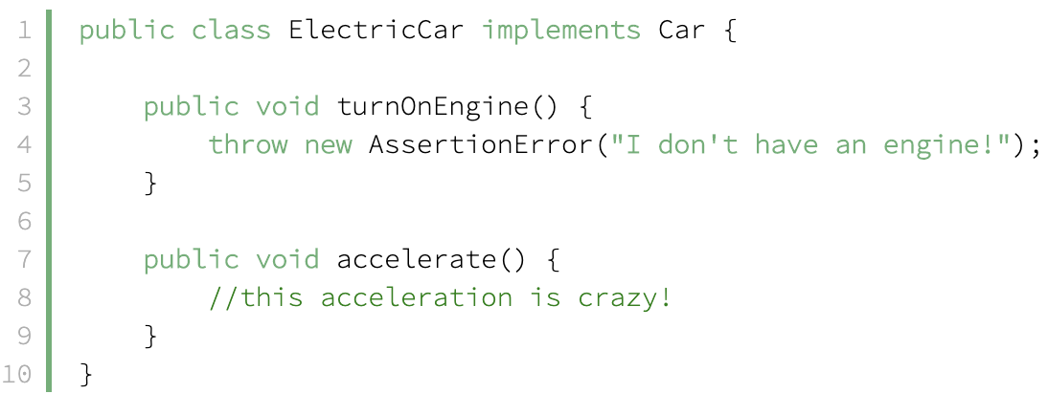
Which SOLID design principle is violated in this code?

Slide 44
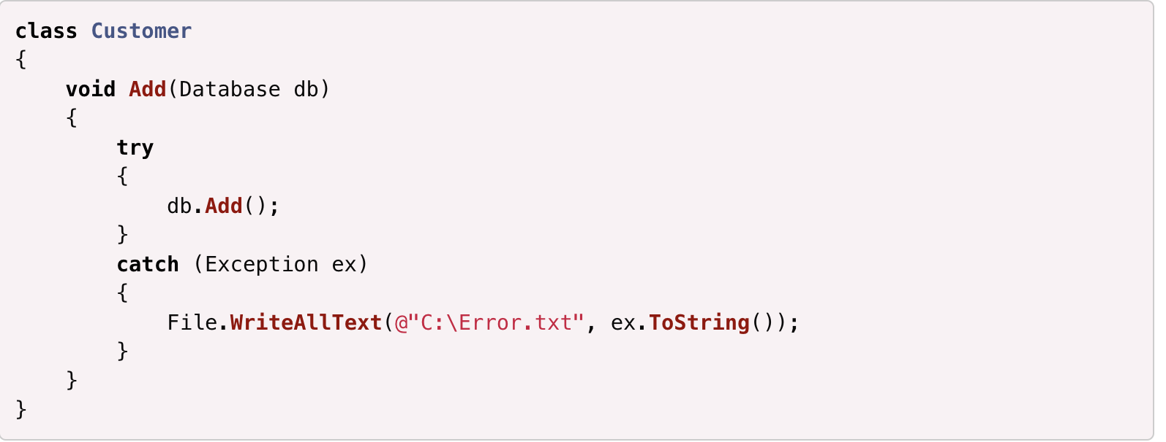
How do you improve this code?

Slide 45
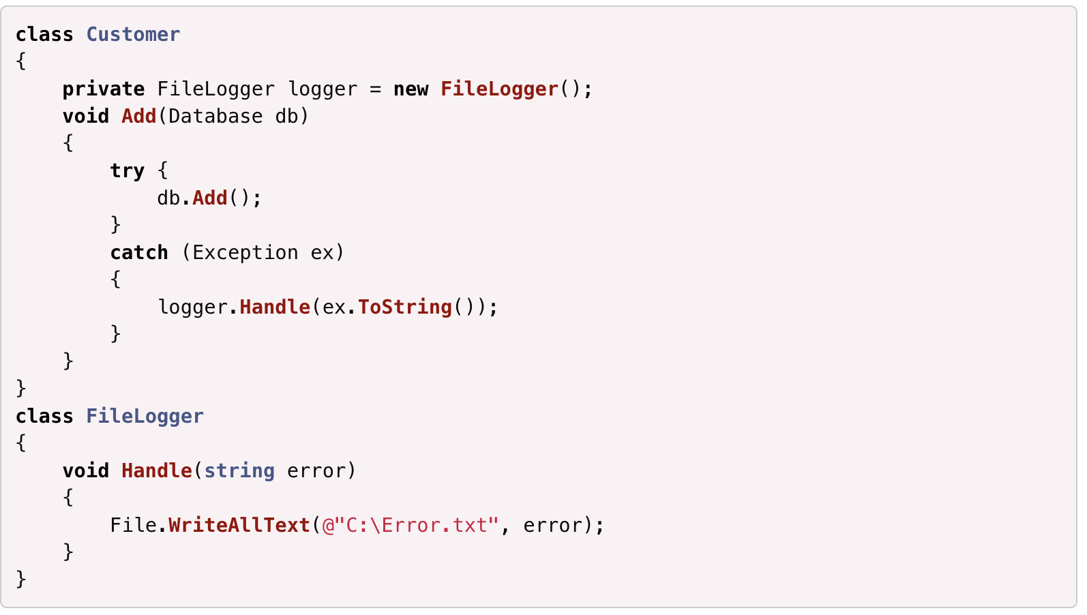
Preserve SRP
Notes:
This doesn’t violate the single responsibility principle by abstracting the logger for the actual writing.

Slide 46
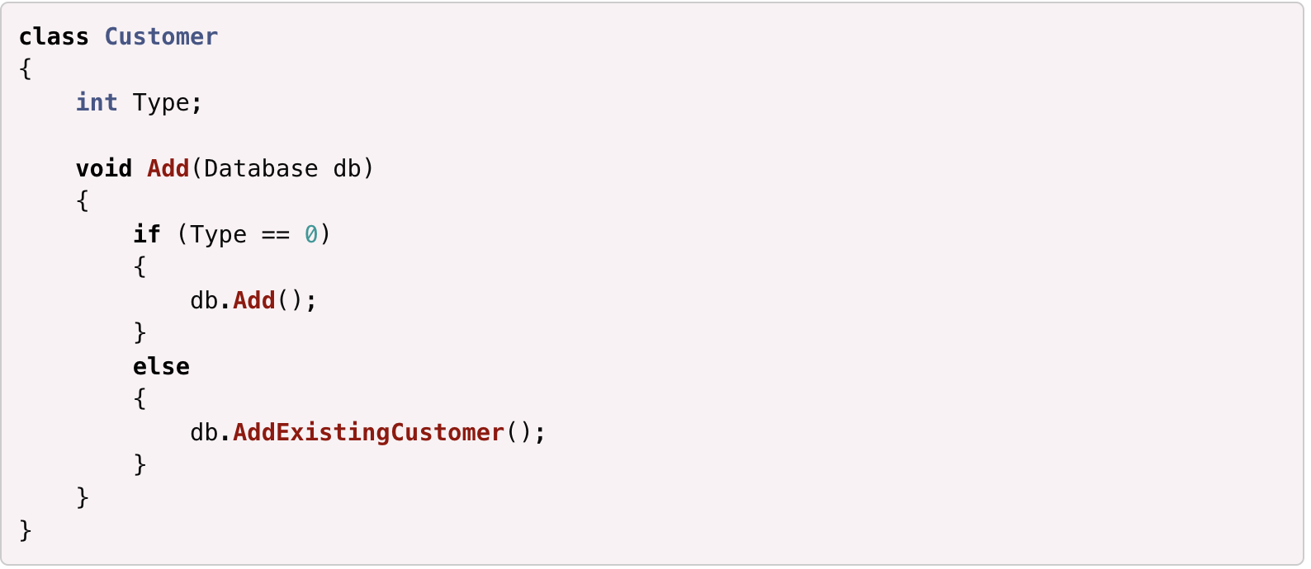
Which SOLID principle is violated by this change to Customer class?

Slide 47
Question?
Imagine you use an external library which contains a class Car. The Car has a method brake. In its base implementation, this method only slows down the car but you also want to turn on the brake lights.
How do you e extend the Car‘s behavior without touching the original class from the library?
You would create a subclass of Car and override the method brake. After calling the original method of the super class, you can call your own turnOnBrakeLights method.

Slide 48
Question?
In an adventure game, you have a class for your main character. The player can either be a warrior or an archer or a wizard. Instead of a class which can perform all the actions, like strike, shoot and heal, you would create three different classes, one for each character type. In the end, you would not only have a Character class but also a Warrior, an Archer and a Wizard, all inheriting from Character and implementing their specific actions.
Which SOLID principle is respected here?
Interface Segregation

